Slide 1
It All Started with a Fairy Tale: Box Office and the Stock Market
Tommie Chen
July 7, 2015

Slide 2



Predict the Stock Market's Direction

Slide 3
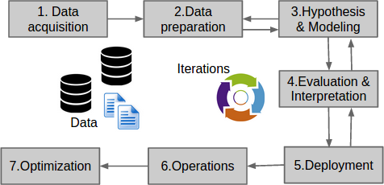
The Data Science Project Lifecycle
* credit: www.datasciencecentral.com

Slide 4
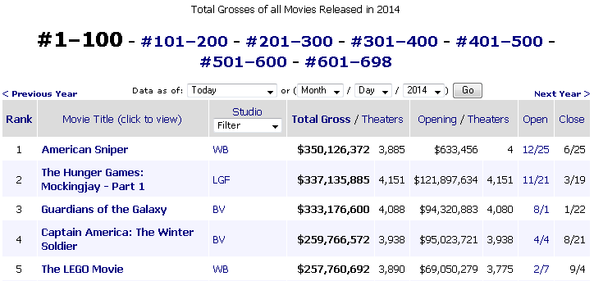
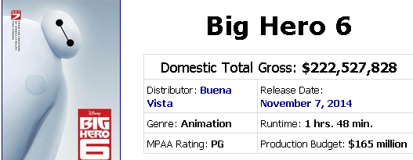
Data Acquisition
Source #1
Source #2
* credit: http://www.boxofficemojo.com

Slide 5
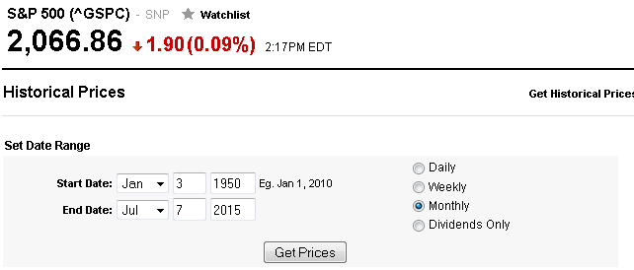
Data Acquisition
Source #3
* credit: http://finance.yahoo.com

Slide 6
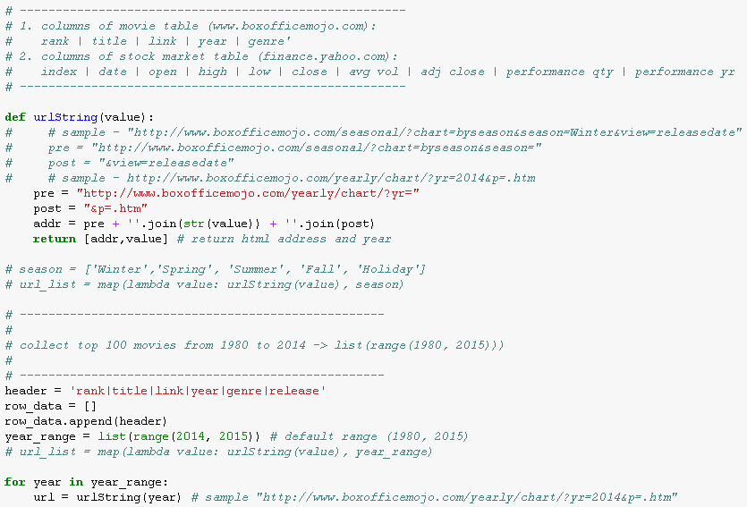
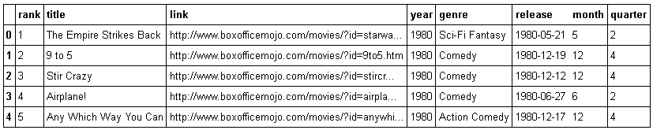
Data Preparation (Box Office)

Slide 7
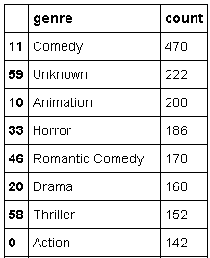
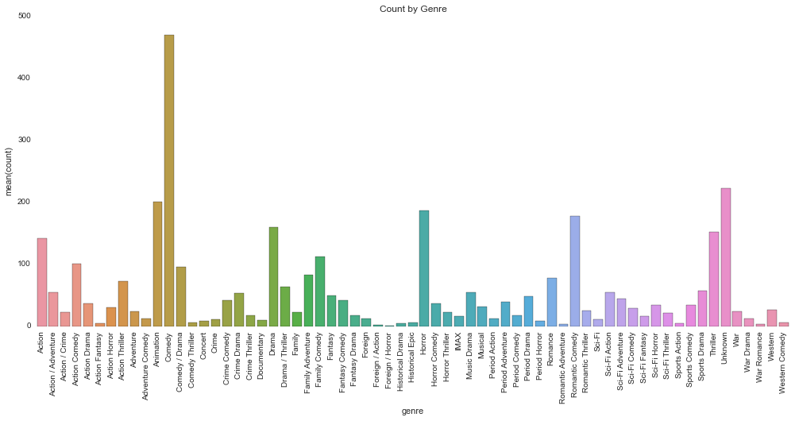
Data Preparation (Box Office)

Slide 8
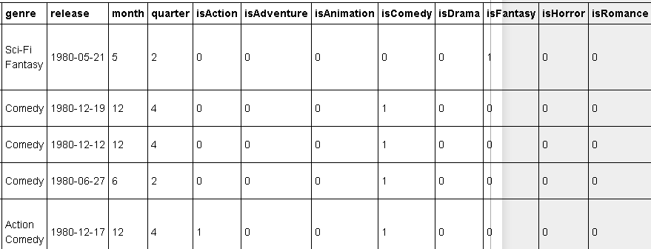
Data Preparation (Box Office)

Slide 9
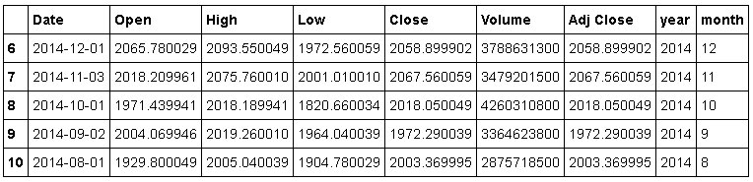
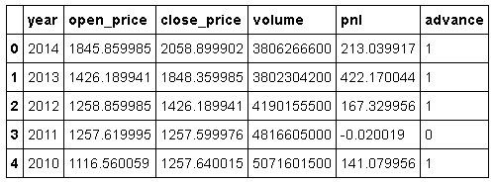
Data Preparation (S&P 500)

Slide 10
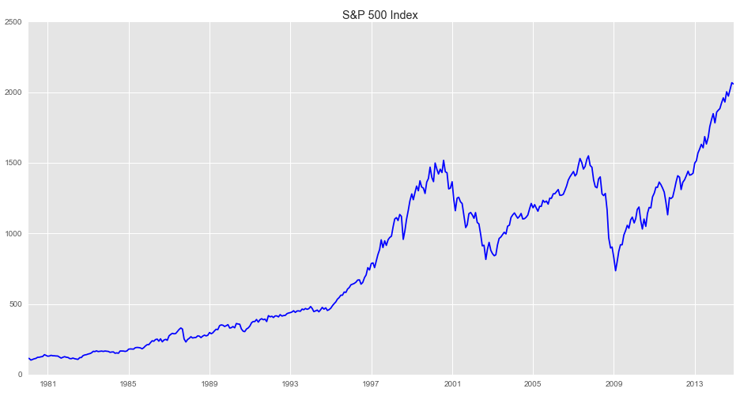
Data Preparation (S&P 500)

Slide 11
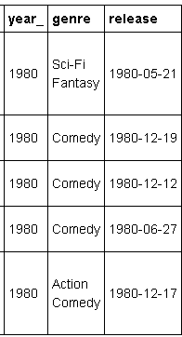
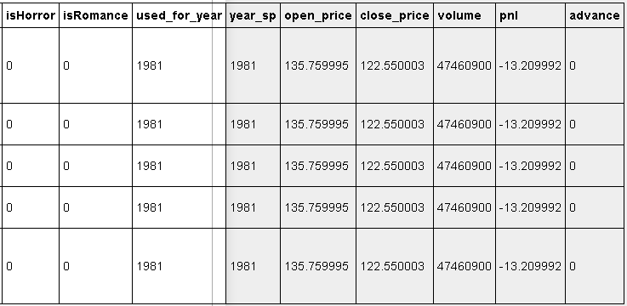
Data Preparation (Merge)
Movie Release
Prediction For
Stock Market
....

Slide 12

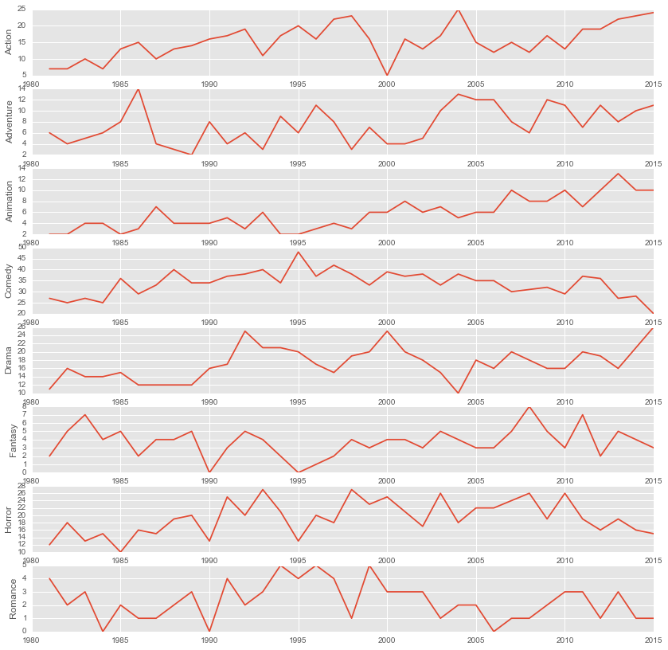
Data Preparation (Merge)
1997
2001
2005
2009
2013

Slide 13
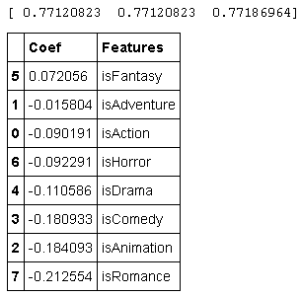
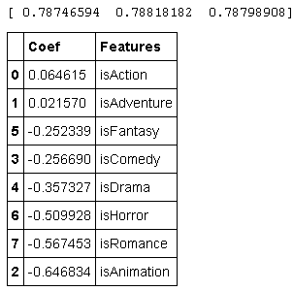
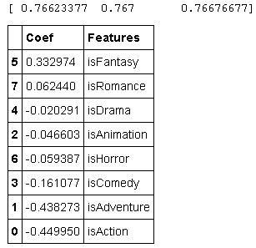
Modeling with Logistic Regression
T+0 Year
T+2 Year
T+5 Year

Slide 14
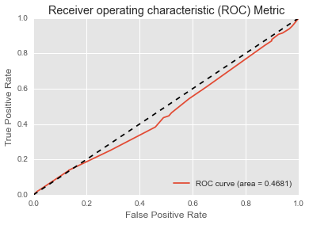
Evaluation of Predictions
* A big flaw found – Prediction for the Current (T+0) Year

Slide 15
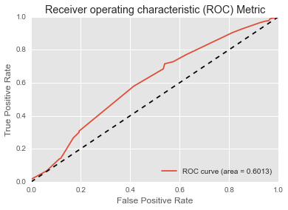
Evaluation of Predictions
* Prediction for Market Trend in T+2 Year

Slide 16
Thanks A 1 x 10⁶

